Slide 1
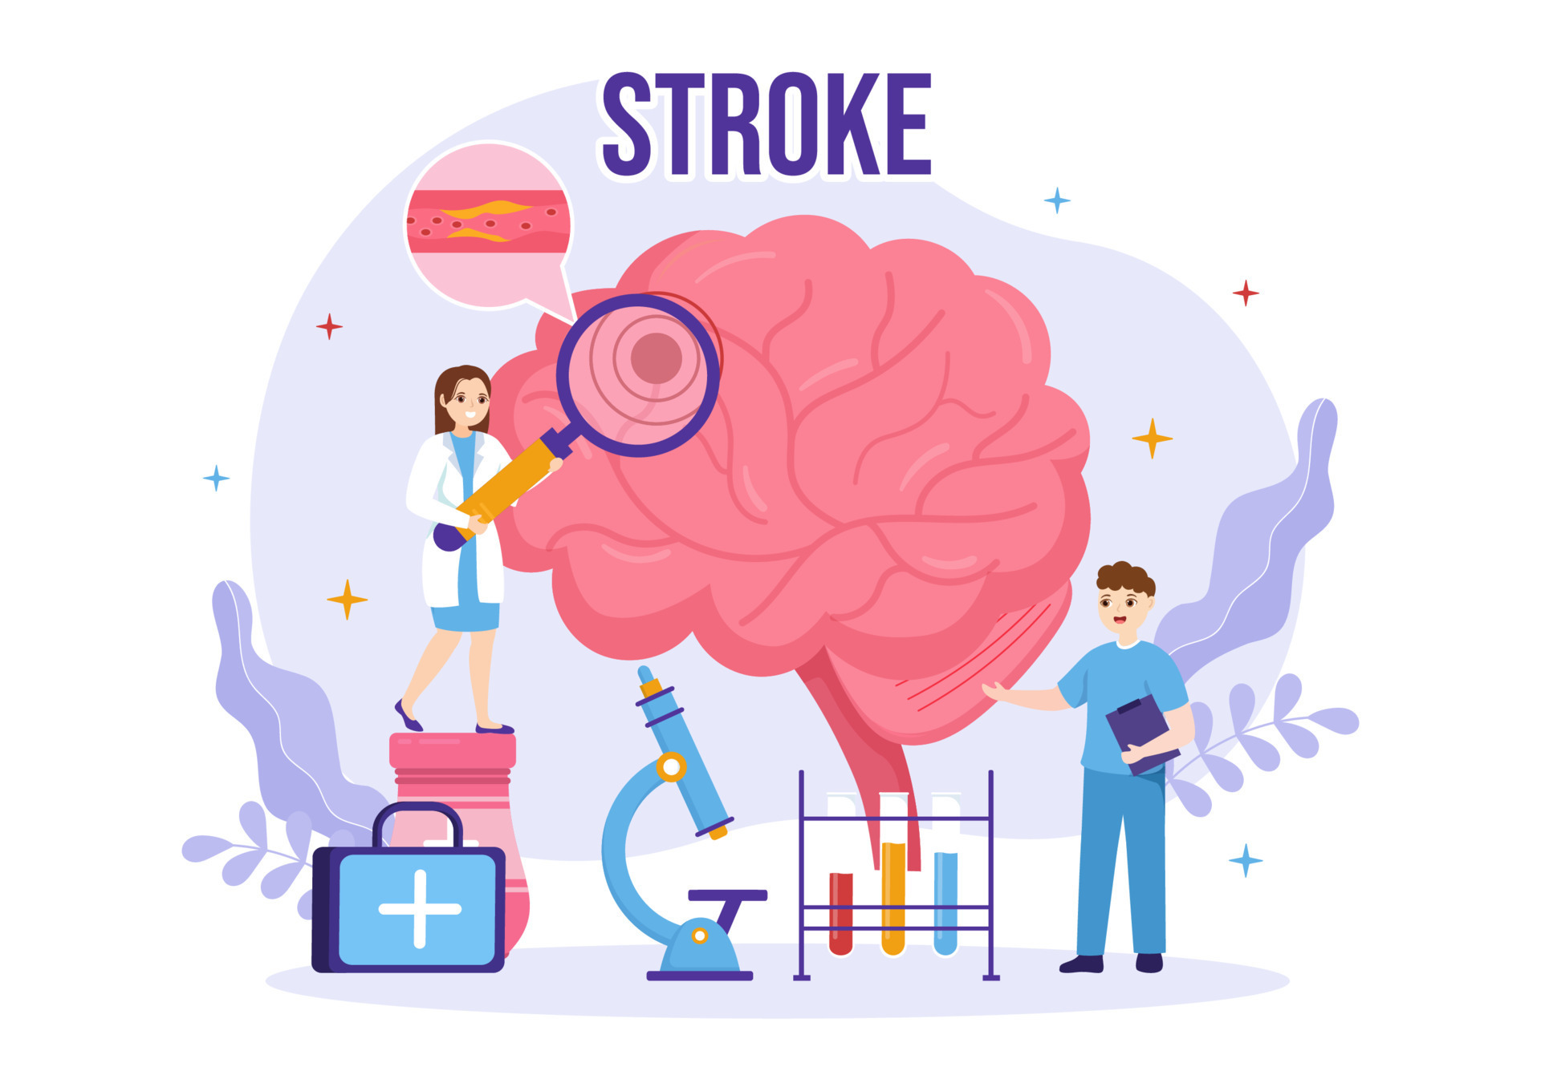
Stroke Risk Analysis Identifying Key Predictors Using the WHO Healthcare Dataset
MSDS670 — Data Visualization
Harsha Vardhini Danala

Slide 2
Research Question
Stroke is the second leading cause of death worldwide.
This project analyzes healthcare records to identify factors associated with stroke risk.
Research Question:
What demographic and clinical factors are most strongly associated with stroke risk in the WHO Healthcare Stroke Dataset?

Slide 3
Dataset & Methodology
Dataset: WHO Healthcare Stroke Prediction Dataset with 5,109 patient records.
Features include demographic, lifestyle, and medical variables such as age, glucose level, heart disease, and smoking status.
Data analysis and visualizations were created using Python, Pandas, and Matplotlib.

Slide 4
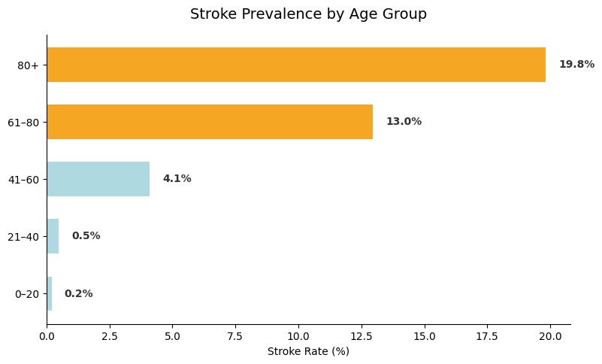
Stroke Rate by Age Group
Patients 80+ face a 19.8% stroke rate — nearly 100× higher than the 0–20 age group (0.2%). Risk escalates sharply after age 60, crossing the high-risk threshold. Age is the single strongest predictor of stroke in this dataset.

Slide 5
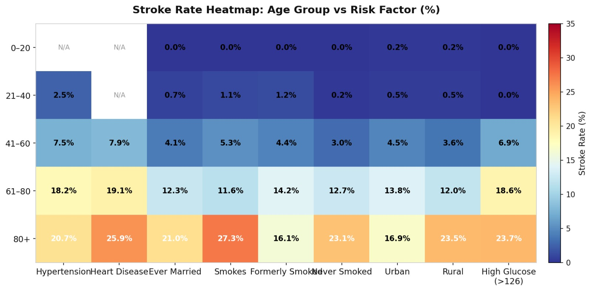
Stroke Risk Heatmap: Age Group vs Risk Factor
The heatmap reveals that stroke risk increases dramatically in older age groups, especially after age 60.
The highest risk group is patients aged 80+ who smoke, with a stroke rate of 27.3%.
Multiple risk factors such as smoking, heart disease, and high glucose significantly amplify stroke risk in older patients.

Slide 6
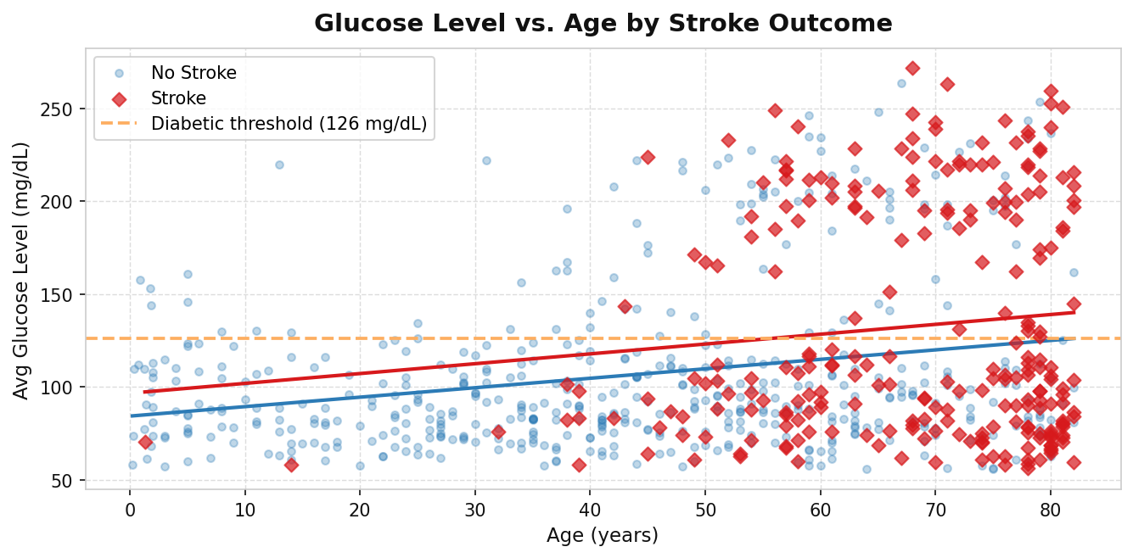
Glucose Level vs. Age by Stroke Outcome
Stroke patients cluster above the 126 mg/dL diabetic threshold far more than non-stroke patients. Both groups show rising glucose with age, but the stroke patients' trend is steeper.
High age combined with high glucose creates a compounding danger zone.

Slide 7
Conclusion
Age is the Dominant Risk Factor
Stroke risk escalates dramatically after age 60, reaching 19.8% for patients 80+. Early screening should target adults in their late 50s.
Cardiovascular Conditions Multiply Risk
Heart disease (17.0%) and hypertension (13.3%) are the strongest modifiable clinical predictors. Managing these conditions can substantially reduce stroke incidence.
High Glucose + Age = Compounding Danger
Elevated blood glucose above 126 mg/dL interacts with age to amplify risk. Older patients with poorly controlled blood sugar need prioritized neurological monitoring.

